Slide 1
ANALYSIS OF NETWORK TRAFFIC USING UNSW_NB15_training-set
NAME: HARUN NDUNG’U CT206/109460/22
UNIT: DATA ANALYTICS AND VISUALIZATION

Slide 2
INTRODUCTION
This presentation analyzes network traffic dataset.
The main goal is to understand how normal and malicious network activities differ.
Simple charts are used to explain patterns in the dataset.
The analysis helps in understanding how cyber attacks appear in real networks.

Slide 3
ABOUT THE DATASET
UNSW-NB15 DATASET
The dataset contains records of network communication.
Each record represents a single network connection.
The data includes;
  Normal network traffic.
  Different types of cyber attacks.
It is commonly used for cybersecurity research and learning.
KEY:
The data set helps us to study how attacks behave compared to normal traffic.

Slide 4
DATA CLEANING
Why Data Cleaning was necessary
Some of the columns in the dataset did not add useful information.
A few columns contained repetitive or empty values.
Data cleaning helps;
  Improve accuracy.
  Make charts easier to understand.
Only meaningful data was retained for analysis.

Slide 5
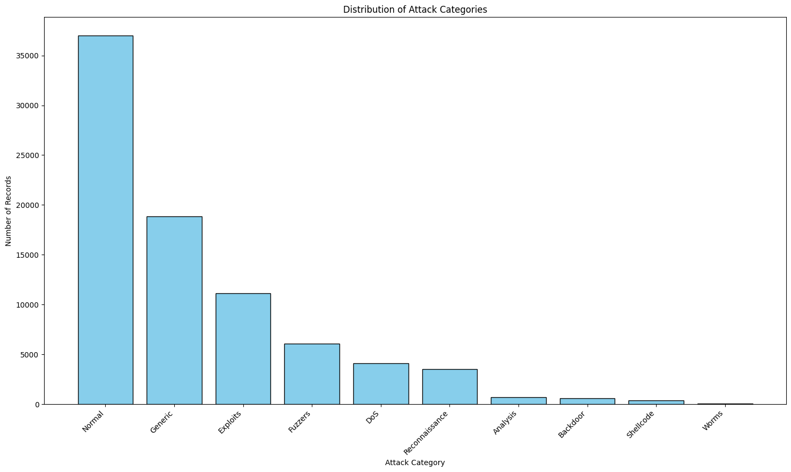
ATTACK CATEGORY DISTRIBUTION (BAR CHART)

Slide 6
ATTACK CATEGORY DISTRIBUTION
What the above chart shows.
Different types of cyber attacks in the dataset.
Normal traffic appears more than attack traffic.
Some attacks occur more frequently than others.
NOTE:
This data is imbalanced, meaning normal activity happens more than attacks

Slide 7
INTERPRETATION OF ATTACK CATEGORIES
What can we learn from this?
Normal traffic dominates the network.
Common attacks include:
  Generic attacks.
  Exploits.
  Reconnaissance
Rare attacks such as worms and backdoors occur less often
Why this matters:
Rare attacks are harder to detect and require special attention in security systems.

Slide 8
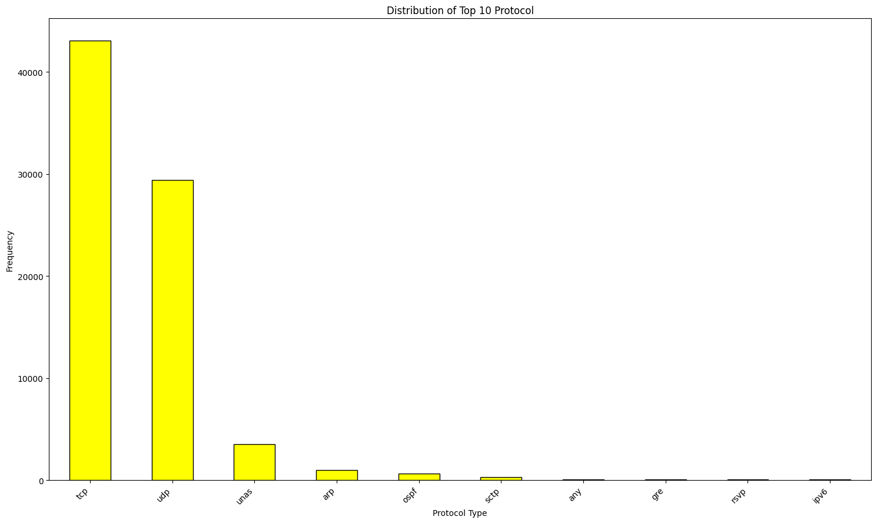
PROTOCOL DISTRIBUTION (BAR CHART)

Slide 9
PROTOCOL DISTRIBUTION
What is a protocol?
A protocol is a standard set of rules and conventions that govern how data is formatted, transmitted and received between devices.
What the protocol distribution bar chart shows:
TCP is the most commonly used protocol.
UDP and ICMP follow.
Other protocols appear less frequently.

Slide 10
INTERPRETATION OF PROTOCOL DISTRIBUTION
What this means;
Most communication uses TCP.
UDP is used for faster but less reliable communication.
ICMP is mainly used for network testing and diagnostics.
Security insight:
Unusual increases in rare protocols may indicate suspicious activity.

Slide 11
SUMMARY
Main Insights from the Analysis
Network traffic is dominated by normal activity.
Cyber attacks exist in different forms and frequencies.
TCP is the most common communication protocol.
Visual analysis helps identify unusual patterns quickly.

Slide 12
CONCLUSION
Final Remarks
Visual analysis makes complex data easier to understand.
Understanding network behavior is important for cybersecurity.
The findings can help in designed better security monitoring systems.
Simple charts can effectively communicate important insights.

Slide 13
THANK YOU

